Slide 1

Swire Coca-Cola
Analysis
by
Lindsey Ahlander, Ashley Goldstein, Kyle Aagard, Eliza Baier
Notes:
Hello!
I’m Lindsey and I am joined today by Ashley, Kyle, and Eliza. Today we’ll walk through our key findings from our cart-abandonment analysis for Swire Coca-Cola.

Slide 2
Contents
Business Problem
Key Takeaways
Modeling & Analysis
Limitations
Next Steps
Q&A
Notes:
We’ll begin by outlining the business problem posed by cart abandonment.
Then we’ll share the key takeaways from our analysis.
Next, we’ll walk through our modeling approach and the insights our analysis revealed.
We’ll discuss the limitations and considerations of our analysis.
Finally, we’ll present our recommendations and propose next steps.
We’ll close by leaving time for any questions or comments.

Slide 3
01
Business Problem
Notes:
I’ll start us out by outlining the business problem.

Slide 4
Customers abandoning carts
Various factors influence abandonment
Pinpoint at-risk customers for intervention
Identify patterns that drive abandonment
Notes:
Cart abandonment poses an interesting business problem. It occurs when a customer loads items into their cart but doesn’t complete the purchase.
There are a variety of factors that can influence and drive cart abandonment
The goal of our presentation is to walk you through our analysis which identifies the key behaviors and patterns that drive cart abandonment,
and ultimately help Swire identify at-risk customers and so that they can intervene when possible.

Slide 5
14.8%
Notes:
Guided by Swire’s definition, we identified abandoned carts by tracing each customer’s cart history and flagging those that didn’t end in a purchase event.
this approach lead us to a cart abandonment rate of 14.8%.
In a moment, Kyle will walk us through exactly how we identified and calculated this metric.

Slide 6
02
Key Takeaways
Notes:
For now I’ll share our key takeaways

Slide 7
Why does abandonment occur?
Abandonment results from behavior loops
Purchased carts show linear, predictable paths
Cart editing, item searching, and repeated navigation are strongest predictors
Notes:
Across our analysis, abandonment doesn’t stem from a single broken step.
It appears as a multi-step behavioral pattern in which customers are getting caught in loops
— where they are researching products, reopening their cart, or repeatedly modifying items without progressing to checking out.
Customers who complete their orders tend to follow a far more linear path.
Ultimately, abandonment points to friction: customers know what they want, but the interface or product information isn’t helping them get there.

Slide 8
Who is most likely to abandon?
Restaurant and Distributor accounts show strongest patterns
Smaller segments show simpler, occasional ordering behavior
Notes:
When we look at segmentation, the customers who abandon most are Restaurants and Distributors. they paint a very clear picture of what drives cart abandonment.
they tell us two things.
First, these high-volume customers are highly predictable, so the friction points are easy to pinpoint.
Second, abandonment isn’t driven by low intent.
These are committed customers who are getting slowed down by checkout confusion or unclear product information.
In contrast, smaller segments order more sporadically and aren’t getting caught in the same friction loops.
The takeaway here is that the biggest opportunity lies with our highest-value customers: reducing friction for large accounts will generate the greatest revenue impact.

Slide 9
03
Modeling & Analysis
Notes:
I’ll now turn it over to Kyle to introduce our modeling and analysis efforts.

Slide 10
What is an abandoned cart?
Notes:
Thank you Lindsey.
First we need to explain how we classified a cart as abandoned.

Slide 11
50,910 unique purchase windows
7,539 abandoned carts
Abandonment rate: 14.8%
Notes:
For this we created purchase windows based on the cutoff times, dates and customer_ids.
This resulted in 50,910 unique purchase windows.
We defined an abandoned cart as when an item was added to a cart in a window and no purchase event occurred after the items were added and prior to the end of that window.
A total of 7,539 of these windows had abandoned carts.
For an abandonment rate of 14.8%

Slide 12
Event Based Analysis
Notes:
For our event analysis, we converted the raw number of events per purchase window into proportions for easier comparison between carts.

Slide 13
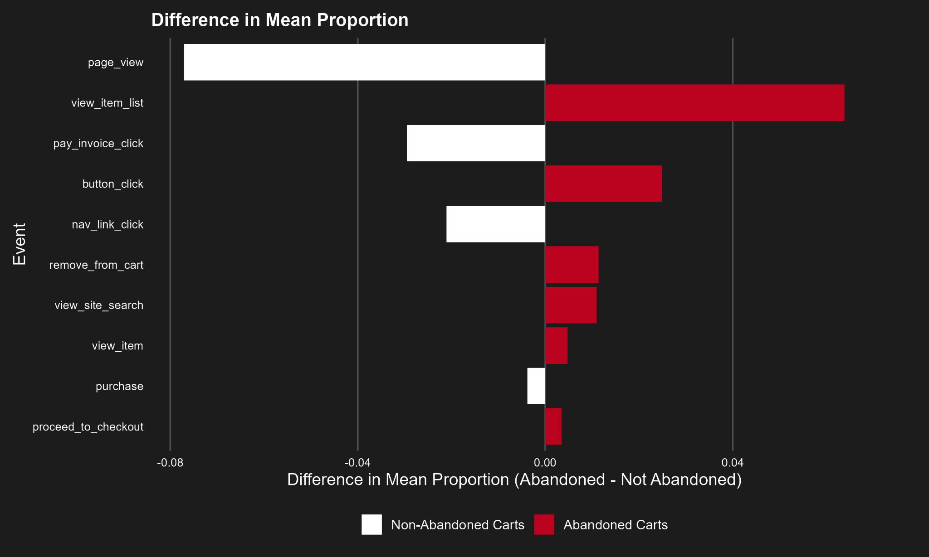
Abandoned carts had a larger proportion of events related to viewing items, searching and cart related activities.
Notes:
For this chart, the red columns represent abandoned carts and the white columns represent non-abandoned carts.
This chart is showing the events from the event_name column that had the largest difference in mean between abandoned and non-abandoned carts.
For example, the view_item_list event occurred about 6% more often in abandoned carts vs non-abandoned carts.
When we looked at the events that that had the largest difference in mean, a pattern emerged that behaviors such as looking at the items list, removing items from the cart and conducting searches occurred with more frequency in abandoned carts vs non-abandoned carts.

Slide 14
Clustering by Events
Notes:
Next in an attempt to gain more insight to the behaviors that lead to cart abandonment, we wanted to see if could identify any clusters using the events in purchase windows.

Slide 15
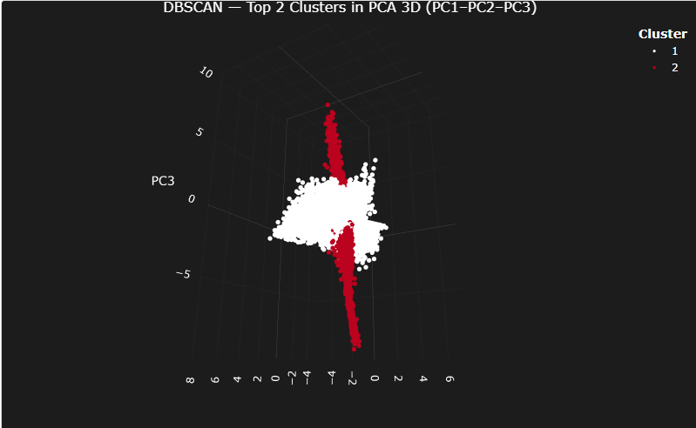
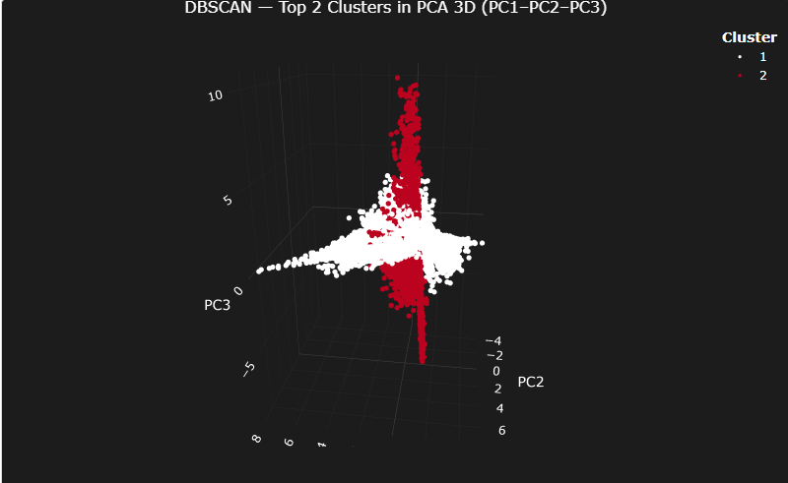
Abandonment Rate by Cluster
Cluster 1: 14.3% (White)
Cluster 2: 17.1% (Red)
Notes:
Using the Dbscan method we were able to find two different clusters based on how frequently an event occurred in individual windows.
The two images below are different angles of the same 3 dimensional plot.
Cluster one, which is shown in white, had an abandonment rate of 14.3%, which is slightly below our overall rate of 14.8%, 46,920
Cluster two,which is shown in red, had a higher abandonment rate of 17.1%. 2,410, noise 1589
Searching for and viewing items were two big components that provided separation between these clusters.

Slide 16
These events appear to be impacting cart abandonment but how exactly is not clear.
Could sequences of these events provide more insight?
Notes:
While events appear to have influence on cart abandonment, we don’t know how. Could looking at sequences events tell us more?
I will now turn it over to Ashley to answer this question.

Slide 17
Association Rule Mining
Notes:
Association rule mining is a technique that finds patterns in sequences of events. Essentially, “What customer behaviors often occur together?” Each rule has three parts: support (how often a sequence of events occur), confidence (the probability that the next event follows), and lift (how much more likely the next event is compared to random chance).

Slide 18
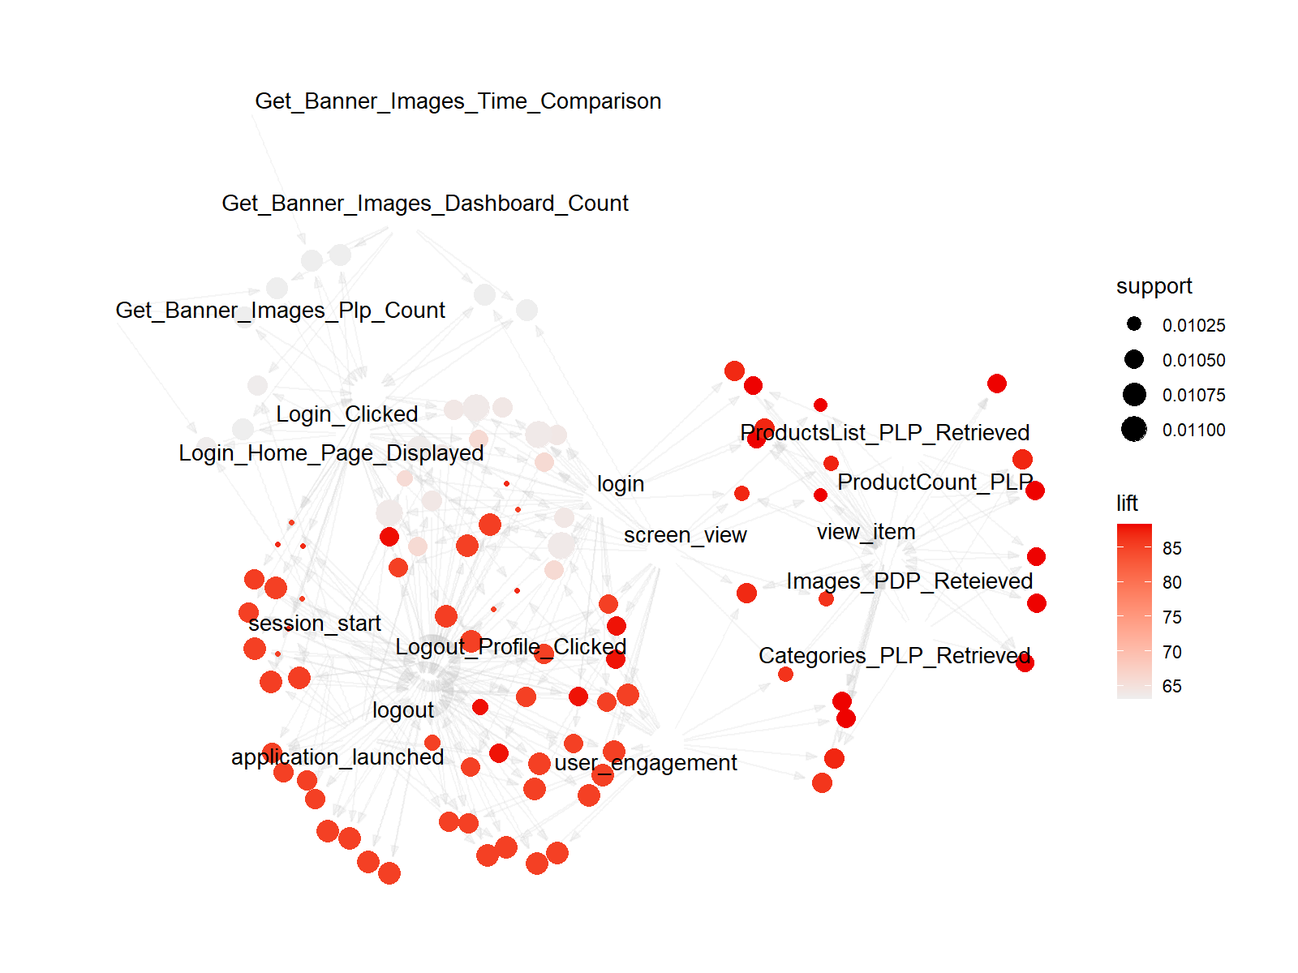
Purchase Cart Behavior
Notes:
This network graph shows the most common event sequences that occur in purchased carts. Each node is an event, and the lines show how customers move from one action to the next. The size of each node reflects support, or how frequently that event appears in purchased cart sequences overall. The color represents lift:darker red nodes appear much more often in purchased carts than we would expect by chance.

Slide 19
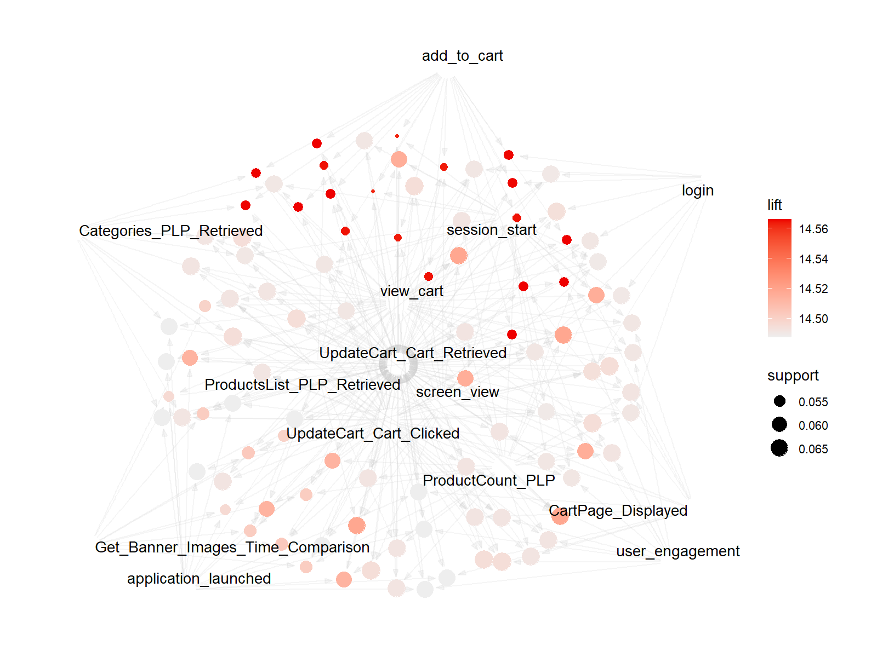
Abandoned Cart Behavior
Notes:
Here is the abandoned cart graph.. Looks a little different, yea?
What stands out is the cluster around view_cart, session_start, update_cart, and add_to_cart. These events form dense, repetitive loops, suggesting customers are searching, reviewing, and changing their cart multiple times without resolving uncertainty. These friction-heavy event cycles are the behavioral signature of abandonment.

Slide 20
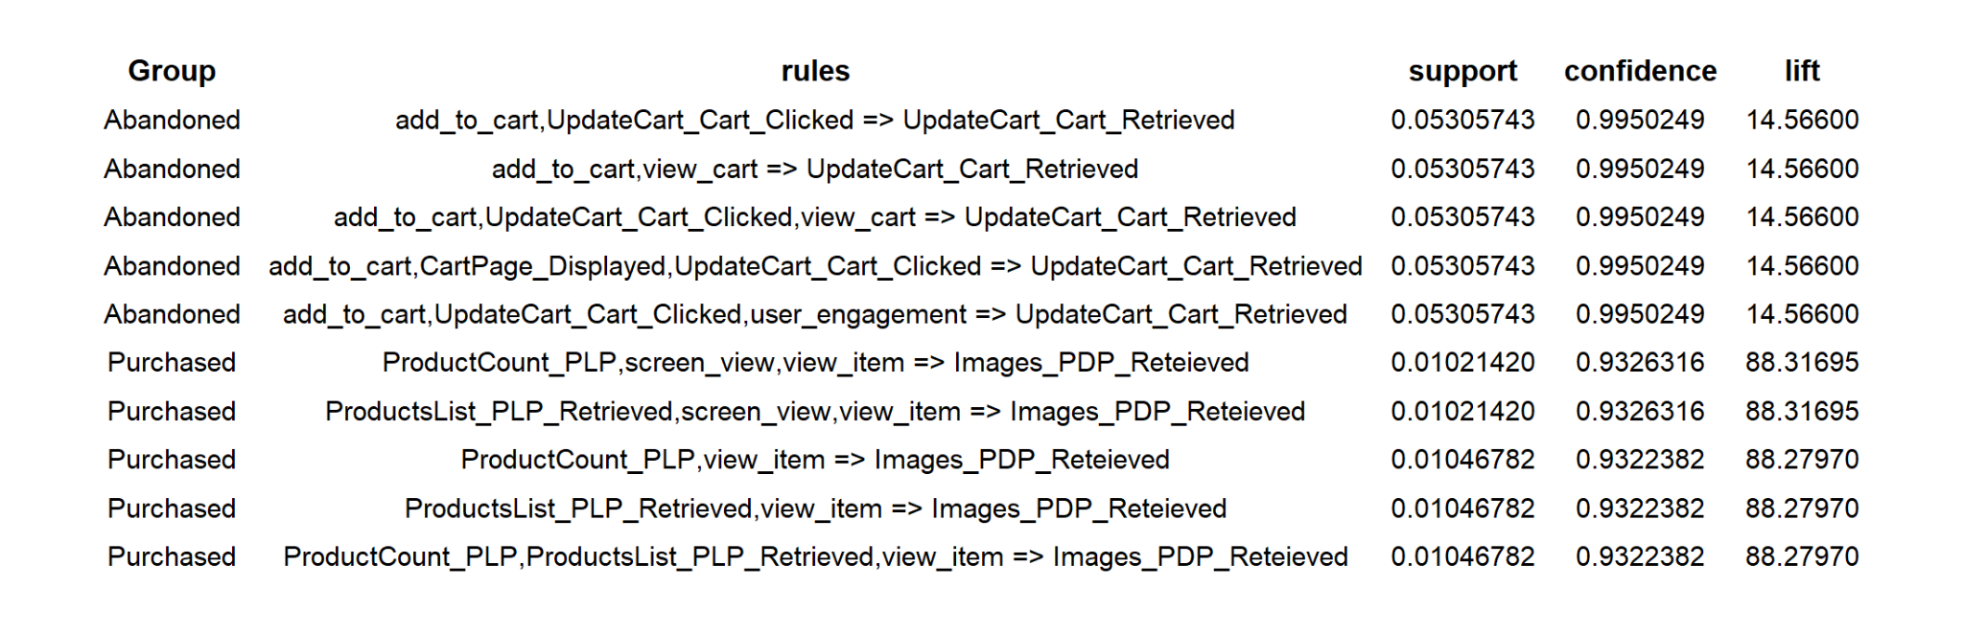
Top 5 Rules
Notes:
Looking at the top five rules for abandoned carts revealed customers who end up abandoning aren’t just clicking once and leaving, instead they enter that loop. These multi-step patterns show uncertainty or friction. They indicate a customer who can’t quite find the right SKU, isn’t sure about the pack size or price, or is running into something that disrupts the flow to checkout. These behaviors cluster together far more often in abandoned orders than in successful ones, which makes them strong early indicators of abandonment risk.

Slide 21
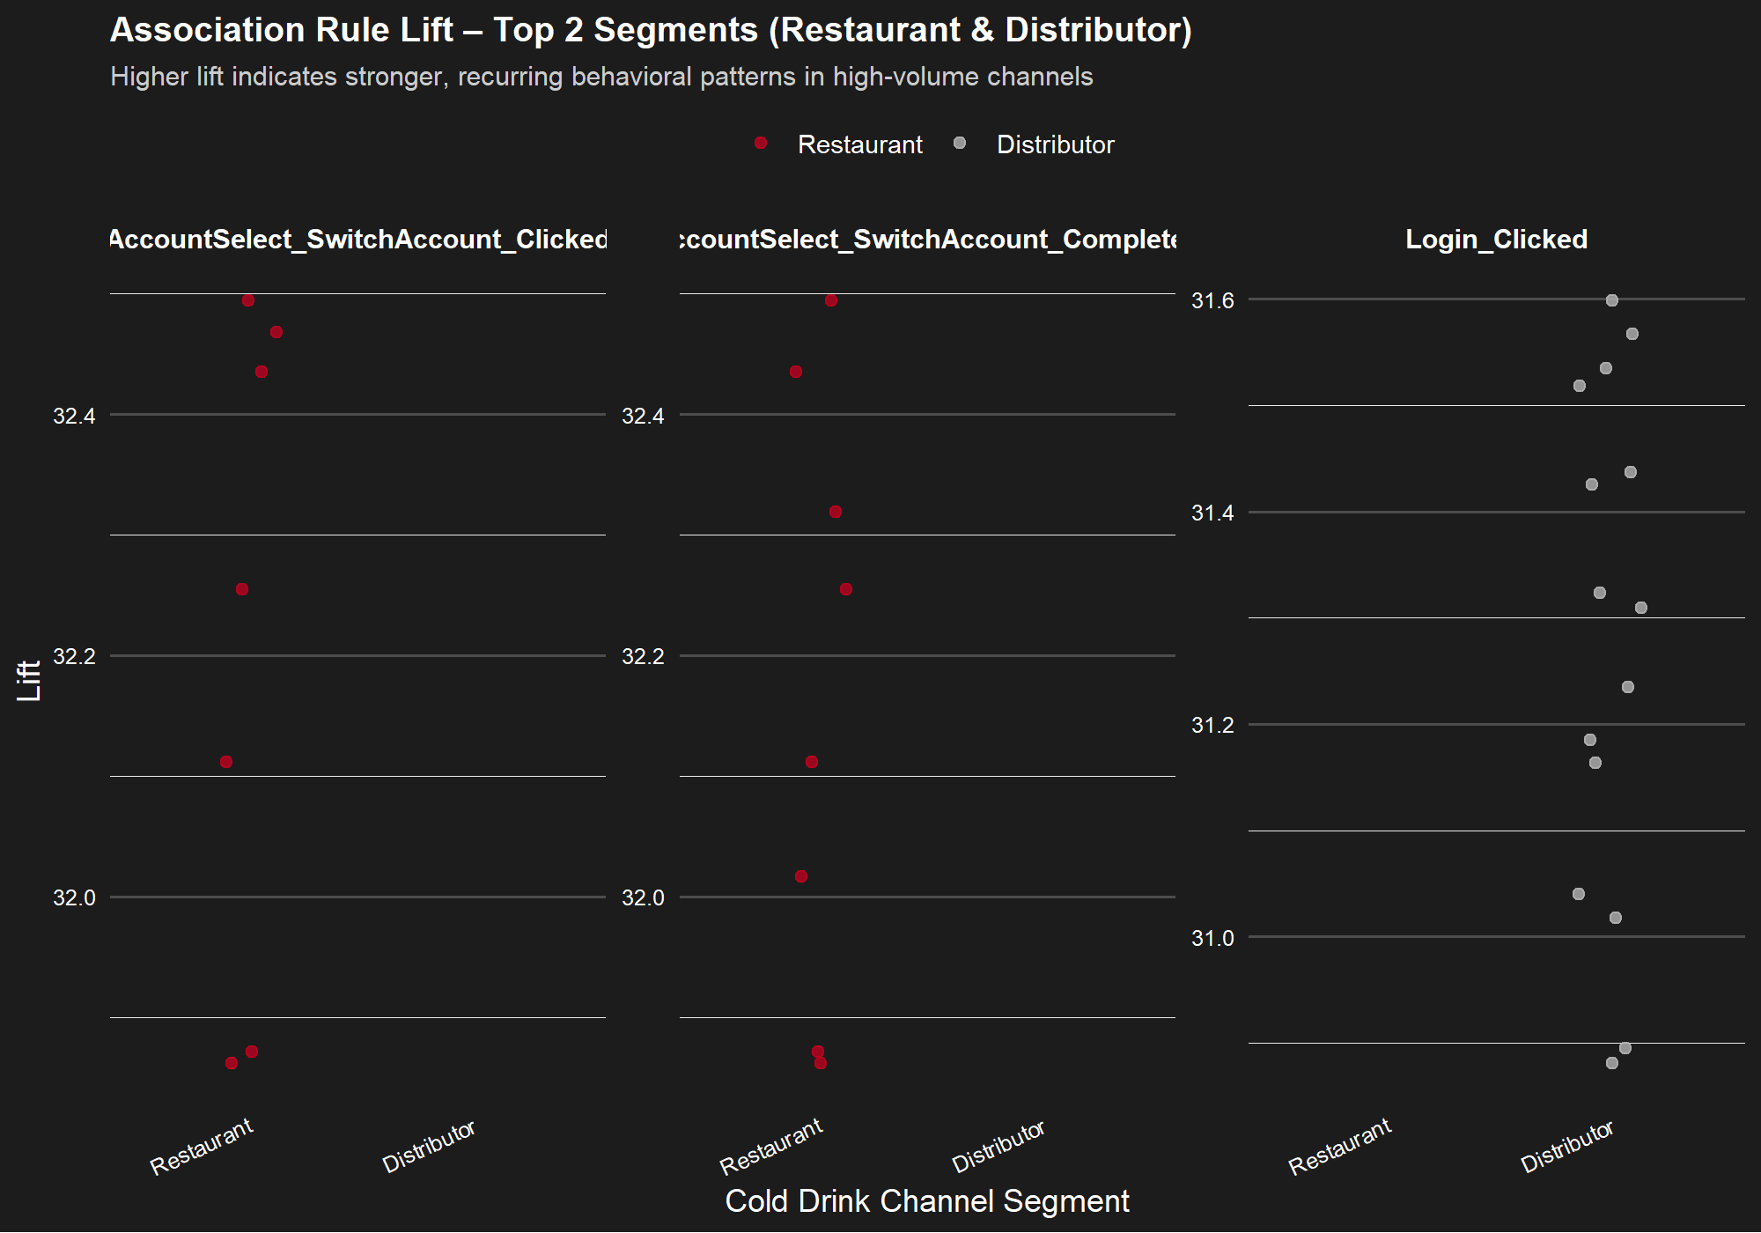
Notes:
This visualization is a bit dense so let me break it down: each point is a rule and we’re comparing the lift of the same rule across the two top-volume segments: Restaurants and Distributors. These are the highest-volume customers, and their ordering behavior is extremely consistent. The high lift values show that when certain events occur together, they strongly predict abandonment.
This tells us two key things: first, these accounts know exactly what they want, but they’re getting slowed down by friction in the digital workflow. And second, because their behavior is so patterned, these customers are highly predictable. We can use these insights to reliably identify the moments where they get stuck (usually during cart modifications and navigation loops) and intervene, whether through interface improvements, simplified cart interactions, or targeted nudges.

Slide 22
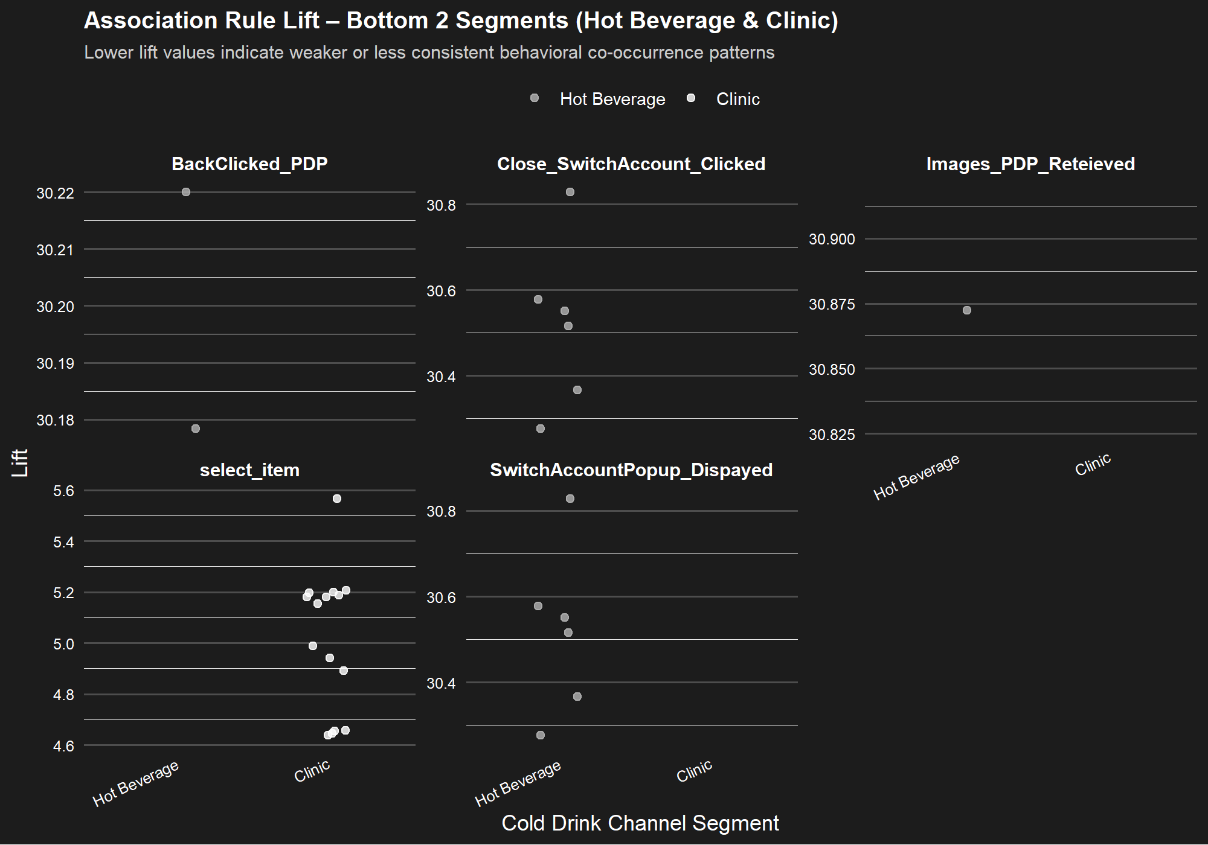
Notes:
In contrast, the Hot Beverage and Clinic segments show much weaker and more diffuse rule lift patterns. These customers interact with the platform infrequently and in a far less structured way. Because their digital behavior is less repetitive, it’s also less predictive, there simply aren’t strong behavioral signals that consistently lead to abandonment.
This doesn’t mean these customers are disengaged; it’s just their abandonment is more related to the natural variability of low-frequency ordering. The takeaway is that while large commercial accounts require targeted usability improvements, smaller segments may benefit more from clearer guidance or simplified workflows rather than deep behavior-based interventions.

Slide 23
What does it mean?
Abandonment is a complex, multi-step journey
Key friction points:
Difficulty finding the right SKU
Uncertainty about size or pack type
Possible unavailable or inconsistent product information
Notes:
In the end, abandonment isn’t caused by one broken step, it comes from sequences of behaviors that signal confusion, friction, or uncertainty. When customers search multiple times, compare a lot of items, or edit their cart repeatedly, they’re essentially telling us they’re frustrated. The product patterns reinforce this as certain SKUs require more effort to confirm, and without enough clarity or guidance, customers end up dropping the order. These rules give us visibility into the exact moments where interventions for customers experiencing friction could lower cart abandonment rate and recoup revenue.

Slide 24
Logistic Regression & Differential Analysis
Notes:
Thank you Ashley. We furthermore completed a logistic regression and differential analysis that exposed an important regional pattern.

Slide 25
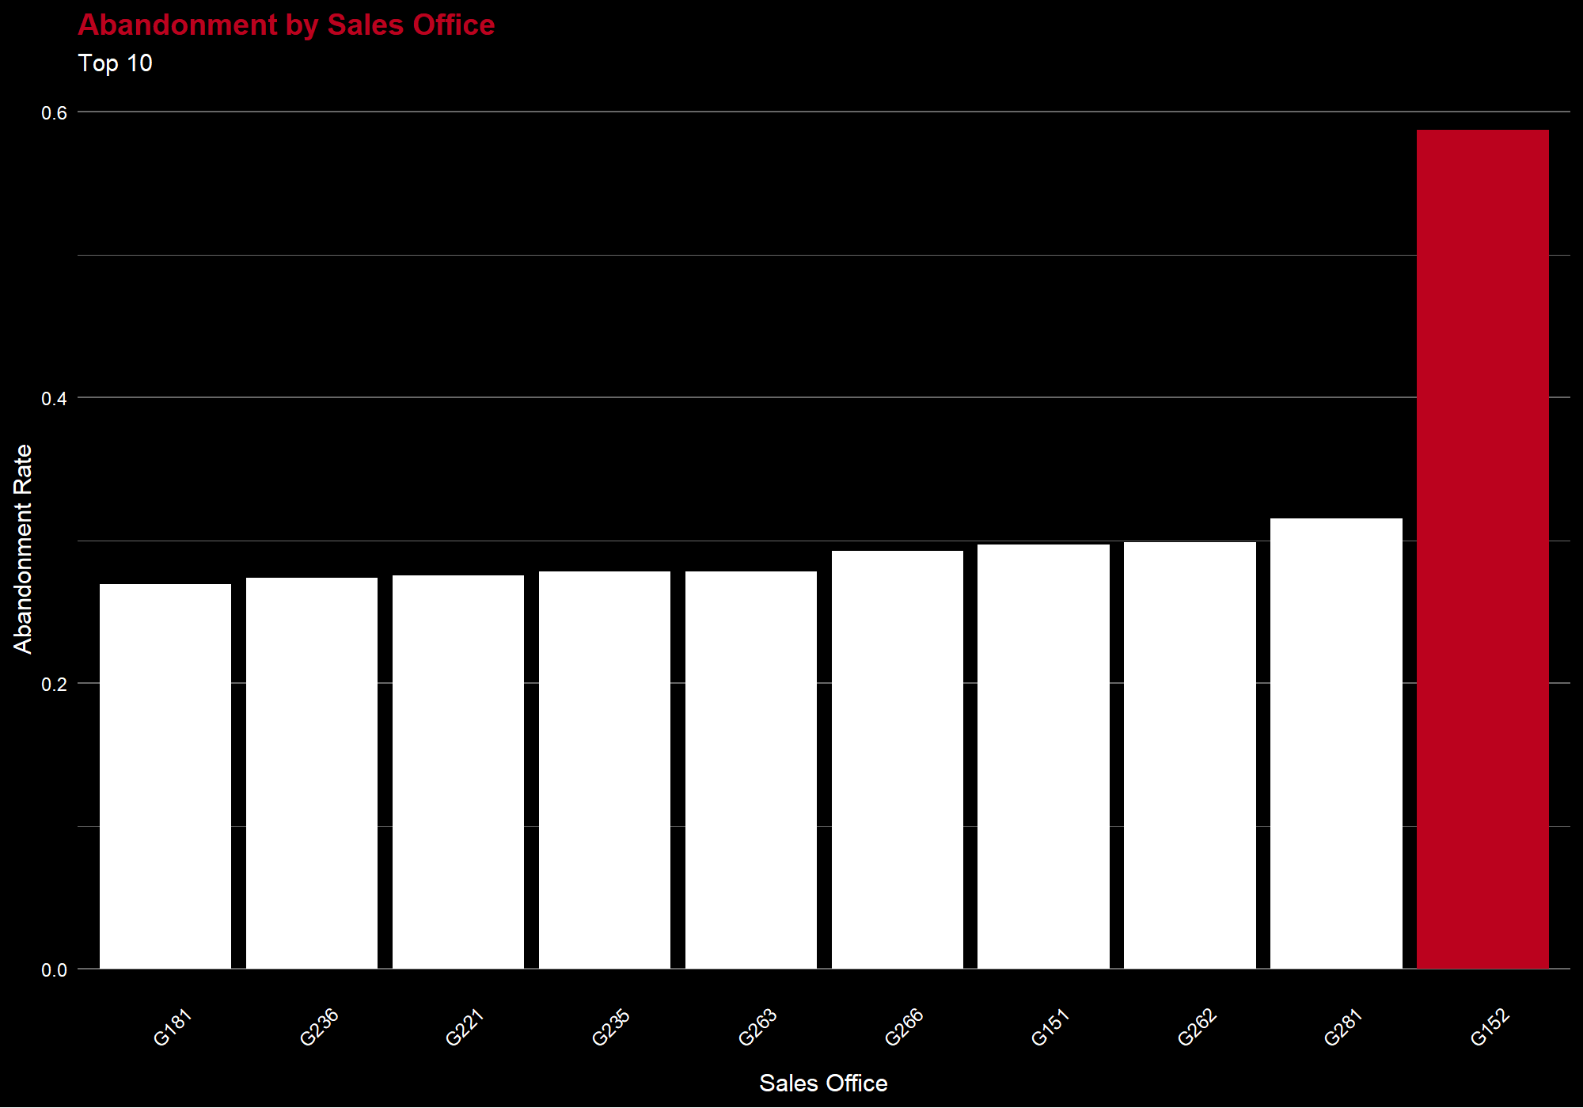
Notes:
When we did this regression analysis, we noticed a significantly higher abandonment rate for the Cheyenne Wyoming sales office location. Given our limited industry knowledge of the situation, we hypothesize that this high abandonment rate is due to stock or delivery issues caused by bad weather and high demand.

Slide 26
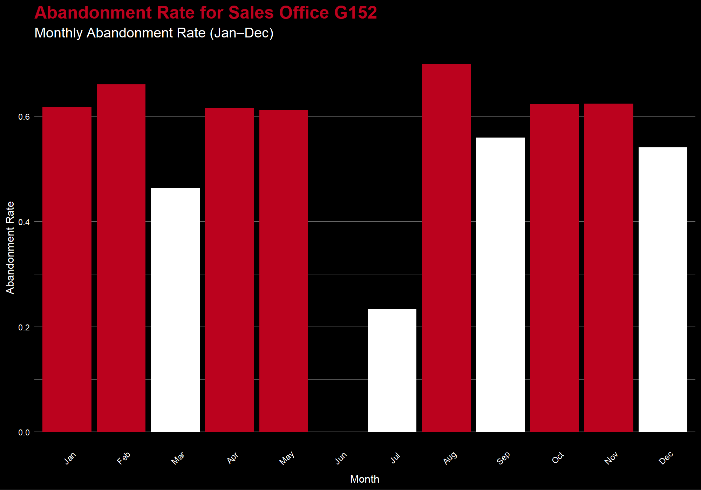
Potential Causes:
Seasonal spikes in demand
Weather events affecting delivery
Inventory shortages following holidays
Notes:
We then did a differential analysis looking for potential weather pattern effects on abandonment rates at the Cheyenne location and discovered an interesting pattern. For this location, 7 out of 12 months had an abandonment rate greater than 60%. Not unexpectedly, some of these high abandonment rates hovered around times when we would expect either a seasonal spike in demand, bad weather that could affect deliveries, or an inventory shortage following a spike in demand. Ultimately, it is clear there is a problem at the Cheyenne sales office but further data and industry knowledge is necessary to fully explore and understand these patterns.
Only two customers in June ordered from Cheyenne Wyoming and neither abandoned their carts.

Slide 27
04
Limitations
Notes:
Next, we’d like to touch on some limitations that we encountered in the data analysis process.

Slide 28
No pre-treatment period
75 missing anchor dates
23k missing critical data
Final = 3.6 million
Notes:
Many of the limitations were described up front but we found two major limitations with the data as we completed this project that were not previously given to us. The first, and most important is that there was no google analytics data provided from before the treatment period so there was nothing to compare to to understand how the new system impacted cart abandonment. Second, due to the nature of the data, we ended up losing some rows during the data transformation and merging process. We lost 75 rows to missing anchor dates and 23 thousand rows to missing other critical data points so we ended up with just over 3.6 million rows of data. We concluded that we still had plenty of data to analyze behaviors leading to cart abandonment so we proceeded with the analysis of the remaining data.

Slide 29
05
Next Steps
Notes:
Finally, I’ll talk about next steps and our conclusions

Slide 30
Identify uncertain customers (Restaurants & Distributors)
Further analyze Cheyenne, WY
Targeted interventions
Frictionless checkout experience
Real-time support prompts
Targeted notifications
Notes:
In summary, our analysis uncovered a few notable insights into Swire’s cart-abandonment challenge.
Our key insight is that customers, especially those in the Restaurant and Distributor sectors, who show uncertainty during checkout—those who move in a “loop” pattern while building their carts—are significantly more likely to abandon. This looping behavior signals friction in the process, which creates frustration and ultimately leads customers to walk away. By intervening with customers in the Restaurant and Distributor sectors, Swire will be able to target customers who abandon most frequently and predictably.
Additionally, Swire should leverage their industry knowledge to investigate the unusually high abandonment rate in the Cheyenne, Wyoming sales office. There are hints of seasonality, but the pattern suggests missing context that could reveal something meaningful.
We recommend that Swire explores targeted interventions for uncertain customers, especially Restaurant and Distributor accounts, whether that means streamlining the checkout experience, triggering real-time support prompts, or introducing personalized notifications that help guide hesitant customers back to complete their purchase.
According to our analysis, these interventions could lower cart abandonment rate and recoup revenue from customers that might otherwise abandon their carts.

Slide 31
THANK YOU!
Any questions?
Notes:
Thank you for your time! Are there any questions?

